Slide 1
K Nearest Neighbors ML Model

Slide 2
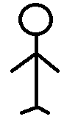

K Nearest Neighbors ML Model
It is a supervised ML model used for classification ( and regression).
More commonly used for classification.
From sklearn.neighbors you can import KNeighborsClassifier or KNeighborsRegressor

Slide 3
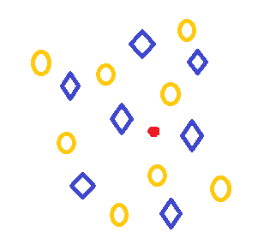
How it works on datasets?
There are total 15 neighboring points near the unknown red point.
These 15 points are from two class(blue diamonds) and (gold circles).
Our aim is to identify the class of red unknown point.

Slide 4
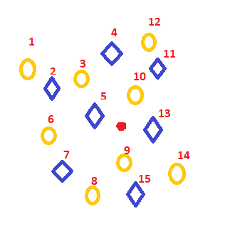
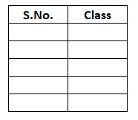
Lets say I identify the value of red unknown point by checking the 5 nearest neighbors.

Slide 5
Steps for KNN Model
Decide the value of k
Calculate the distance of all the datapoints from the unknown point.
Sort the values in ascending order
Get the top k rows from the sorted array
Identify their respective classes and find the most frequently occurred class amount those k points.
That becomes the predicted class on the unknown point.

Slide 6
How to select the optimal value of k?
Some suggestions for how the k value can be selected:
Prefer odd k values, as there are chances of tie in even values.
If still when you take k as odd, and tie occurs, increase or reduce the value of k
K should not be too small.
Thumb rule: k should be generally sqrt(n) , where n denotes total number of data points
Further, one can try different values of k, and then observe the evaluation metrics to decide upon the best value of k

Slide 7
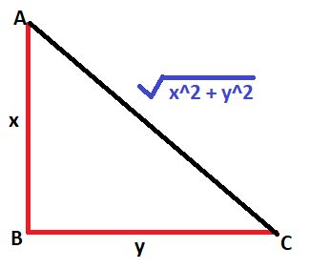
How is the distance measured?
Since KNN model classifies the points based on the proximity or distance. It is important to understand what are the different ways to calculate the distance.
Euclidean distance
By default KNN uses Euclidean distance (Minkowski with power p = 2)

Slide 8
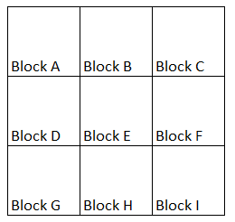
Manhattan distance / city distance/ taxi distance
It is the sum of horizontal and vertical absolute distances.
y2
y1
x1
x2

Slide 9
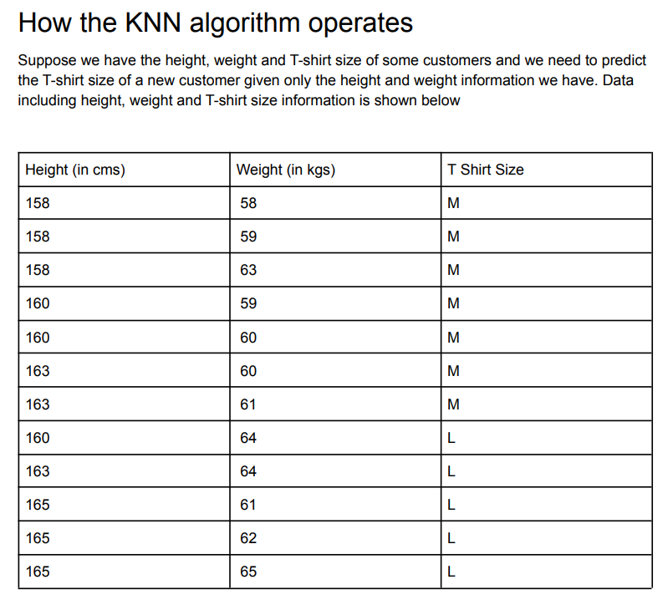

Slide 10
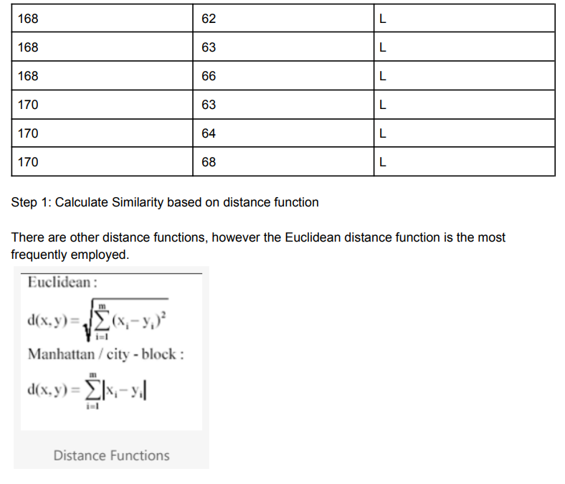
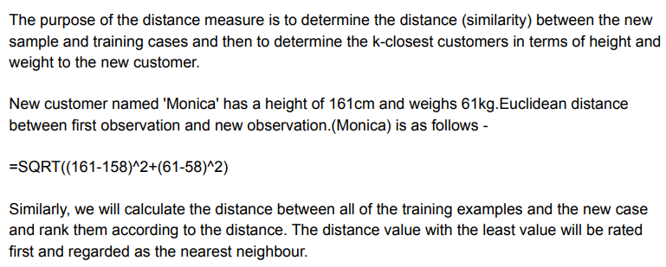

Slide 11
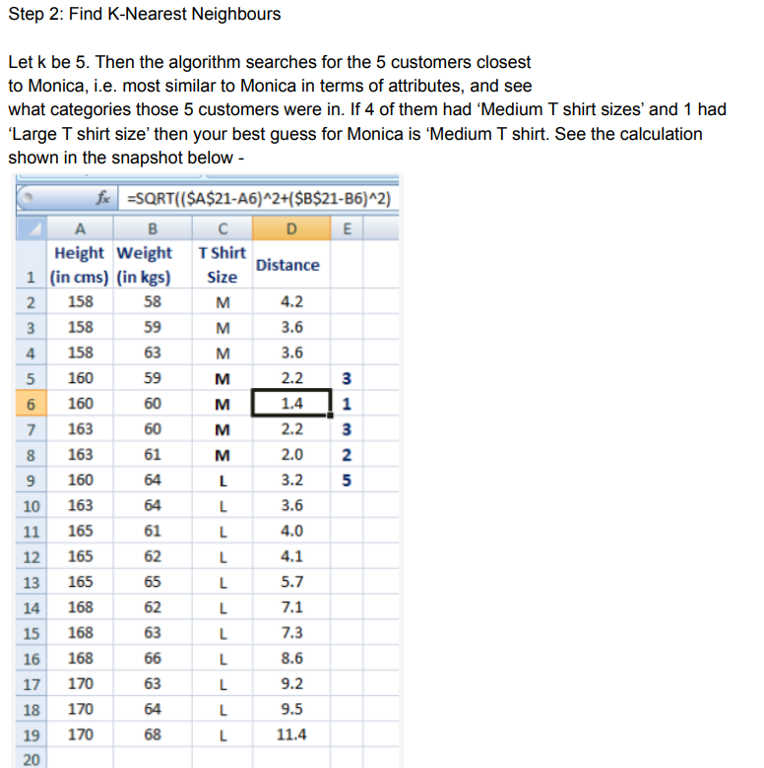

Slide 12
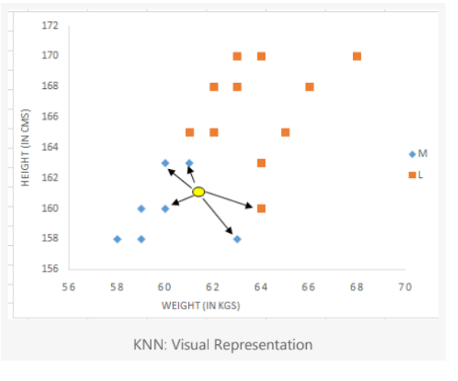
In the graph below, the binary dependent variable (T-shirt size) is displayed in blue and orange color. 'Medium T-shirt size' is in blue color and 'Large T-shirt size' in orange color. New customer information is exhibited in a yellow circle. Four blue highlighted data points and one orange highlighted data point are close to the yellow circle. so the prediction for the new case is a blue highlighted data point which is Medium T-shirt size.

Slide 13
KNN is a Lazy Learner model
Almost all the models get trained on the training dataset, but KNN does not get trained on the training dataset.
When we use knn.fit(X train, Y train) , this model ‘memorizes’ the dataset. It does not understand it or try to learn the underlying trend.
Now when we ask the model to predict some value, then it takes a lot of time because now it actually will have to recall all the points and work around them so that it can help predict the correct value.
Hence where most of the models, take time during training, this model does not take any time during training.
Most of the models take no time in prediction, but KNN model takes lot of time during prediction stage.

Slide 14
During training stage
KNN does not try to establish its underlying trend and the equation.
KNN simply memorizes this dataset as it is!
Now when asked to do prediction, it will recall all values and then try to work around the calculations.
Hence it takes more time during prediction stage.

